Slide 1


Biotechnology Timeline
the history of using scientific knowledge and living systems as tools to solve problems or make useful products

Slide 2
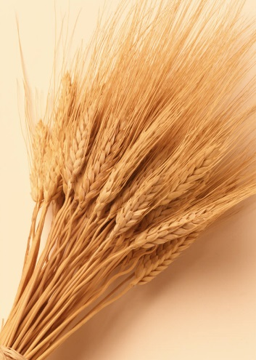

Biotechnology Timeline
8000-4000 B.C.E.
Humans domesticate crops
and livestock.
Potatoes first are cultivated
for food.

Slide 3


Biotechnology Timeline
2000 B.C.E.
Biotechnology is used for the first time
when the Egyptians use yeast to leaven
bread and ferment beer
Production of cheese, fermentation
of wine occur in Sumeria, China, Egypt

Slide 4

Biotechnology Timeline
500 B.C.E.
Chinese use the first antibiotic: Moldy soybean curds for treating boils

Slide 5

Biotechnology Timeline
100 C.E.
First insecticide:
powdered chrysanthemums
(China)

Slide 6
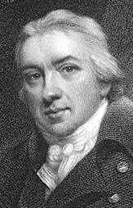
Biotechnology Timeline
1797
First vaccination
Edward Jenner inoculates a
child with a vial vaccine to
protect him from smallpox

Slide 7
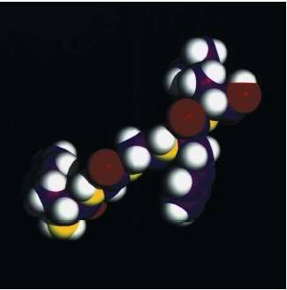
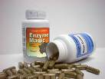
Biotechnology Timeline
1830-1833
1830 Proteins are discovered.
1833 First enzyme is discovered and isolated.
Model of a 5-peptide protein.

Slide 8
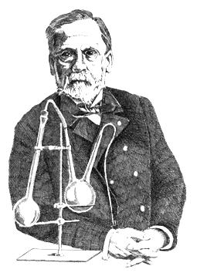
Biotechnology Timeline
1857
Louis Pasteur proposes
that microbes cause
fermentation. He later
conducts experiments
that support
the germ theory of disease.

Slide 9

Biotechnology Timeline
1859
Charles Darwin publishes
the theory of evolution
by natural selection.

Slide 10
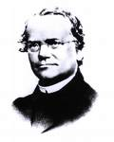

Biotechnology Timeline
1865
The science of genetics begins
when Austrian monk Gregor
Mendel studies flowers in his
garden to develop the basic
laws of heredity

Slide 11
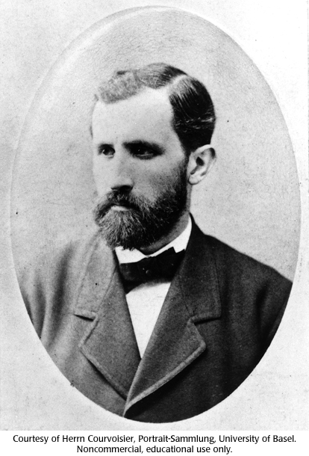
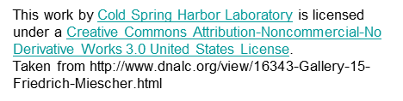
Biotechnology Timeline
1868
The existence of DNA is discovered.
Notes:
This work by Cold Spring Harbor Laboratory is licensed under a Creative Commons Attribution-Noncommercial-No Derivative Works 3.0 United States License.
Taken from http://www.dnalc.org/view/16343-Gallery-15-Friedrich-Miescher.html

Slide 12
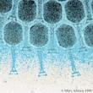
Biotechnology Timeline
1915
Phages — viruses
that only infect bacteria — are discovered.

Slide 13

Biotechnology Timeline
1919
The word “biotechnology” is used in print for the first time.
Image listed as creative commons taken from http://www.berkeleyside.com/2012/01/30/love-books-help-give-away-1-million-of-them/

Slide 14
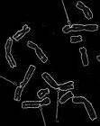
Biotechnology Timeline
1927
Herman Muller discovers
that radiation causes
defects in chromosomes
(mutations).

Slide 15

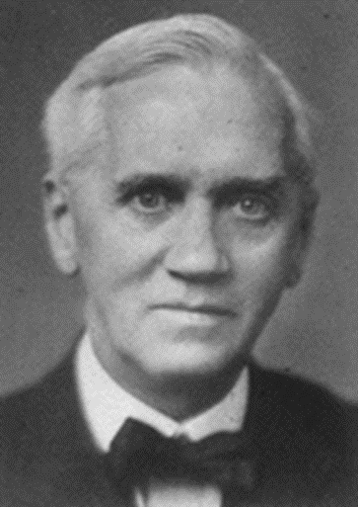
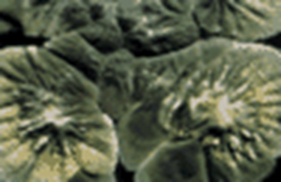
1928
Sir Alexander Fleming discovers
the antibiotic penicillin by chance
when he realizes that
Penicillium
mold kills
bacteria.
He shared the 1945 Nobel Prize in Medicine with Ernst Boris Chain
and Sir Howard Walter Florey.

Slide 16
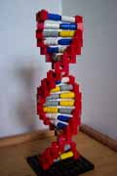
Biotechnology Timeline
1944
DNA is proven to carry genetic information
by Oswald Avery,
Colin MacLeod and Maclyn McCarty.
DNA model made out of LEGOs

Slide 17
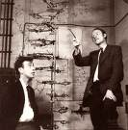
Biotechnology Timeline
1953
James Watson
and Francis Crick describe
the double helical
structure of DNA. They shared
the 1962 Nobel Prize in
Medicine or Physiology with
Maurice Wilkins.

Slide 18
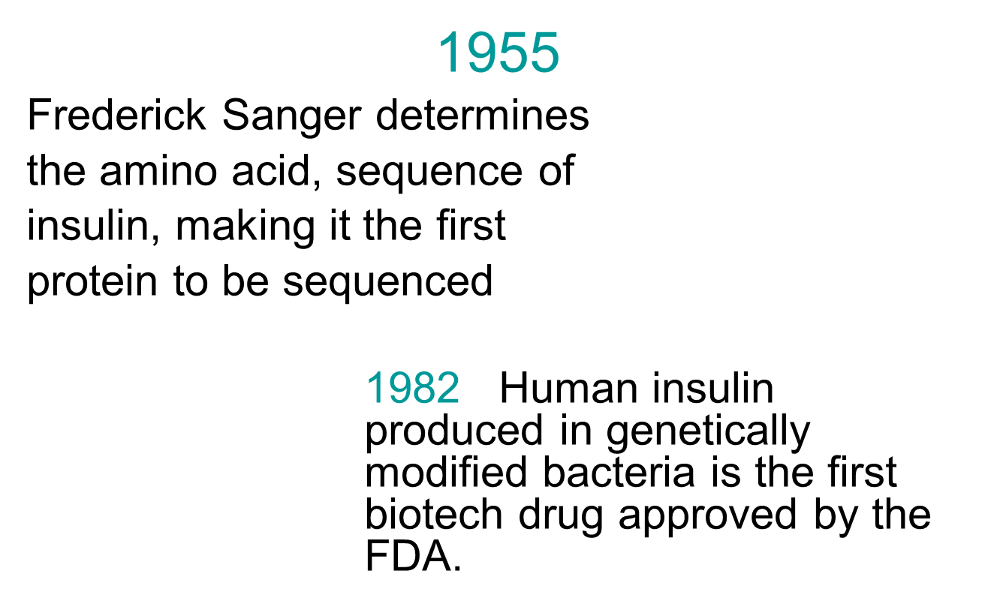
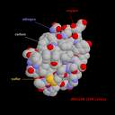


Biotechnology Timeline
3D model of insulin

Slide 19

Biotechnology Timeline
1958
● DNA is made in a test tube for the first time.
● Sickle cell disease is
shown to occur due to a
change in one amino acid.

Slide 20
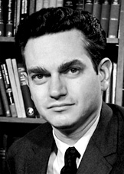
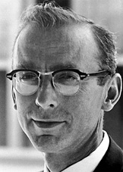
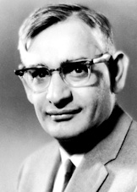
Biotechnology Timeline
1966
The genetic code for DNA is cracked, demonstrating that a sequence of three nucleotide bases (a codon) determines each of 20 amino acids.
Three scientists shared the 1968 Nobel Prize in Physiology or Medicine
for the discovery.
Marshall Nirenberg Robert Holley Har Gobind Khorana

Slide 21
Biotechnology Timeline
1969
An enzyme is synthesized in vitro for the first time.

Slide 22
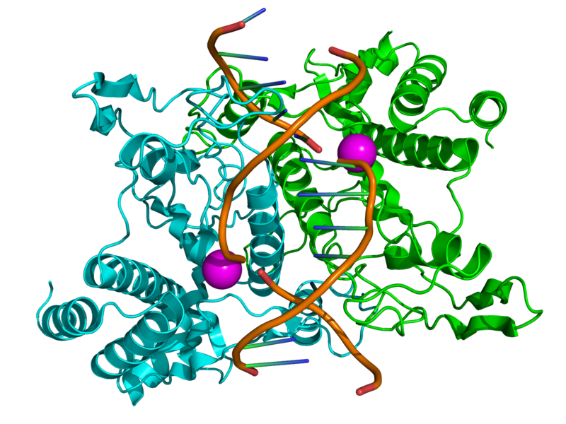
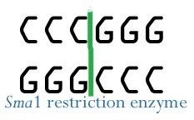
Biotechnology Timeline
1970
Restriction enzymes that cut and splice genetic material are discovered, opening the way for gene cloning.

Slide 23
Biotechnology Timeline
1971
The first complete synthesis of a gene occurs.

Slide 24
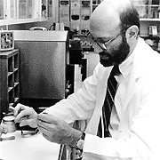
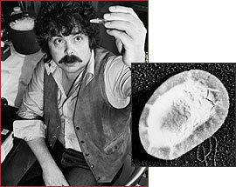
Biotechnology Timeline
1973
Stanley Cohen and Herbert Boyer perfect genetic engineering techniques to cut and paste DNA using restriction enzymes.
(1977 sees the first expression of a human gene in bacteria.)
Stanley Cohen Herbert Boyer and a recombinant bacterium
Cohen won a Nobel Prize in 1986 for an unrelated discovery!

Slide 25
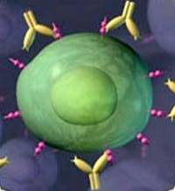
Biotechnology Timeline
1975
Georges Kohler and Cesar Milstein
develop the technology to produce
monoclonal antibodies — highly specific,
purified antibodies derived from only
one clone of cells that recognize
only one antigen. They later would
share the 1984 Nobel Prize in
Physiology or Medicine with Neils Jerne.

Slide 26
Biotechnology Timeline
1977
Genetic engineering is done for the first time, when the first expression of a human gene in bacteria occurs.

Slide 27
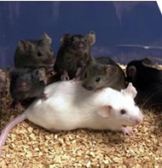
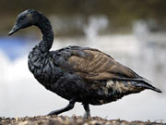
Biotechnology Timeline
1981
The first transgenic animals are produced by transferring genes from other animals into mice.
The first patent for a
genetically modified organism
is granted — for bacteria that can
break down crude oil.

Slide 28
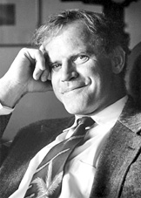
Biotechnology Timeline
1983
The polymerase chain reaction (PCR) technique, which makes unlimited copies of genes and gene fragments, is conceived.
Kary Mullis, who was born in Lenoir, N.C.,
later would win the 1993 Nobel Prize in
Chemistry for the discovery. He became
interested in science as a child when he
received a chemistry set for Christmas.

Slide 29
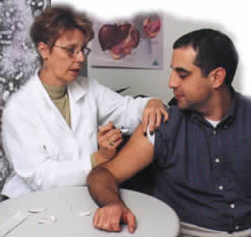
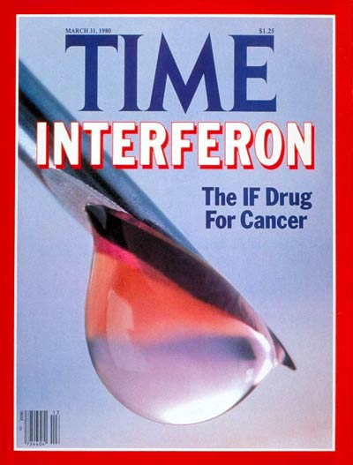
Biotechnology Timeline
1986
First recombinant vaccine is approved
for human use: hepatitis B.
First anti-cancer drug is produced through biotech: interferon.

Slide 30
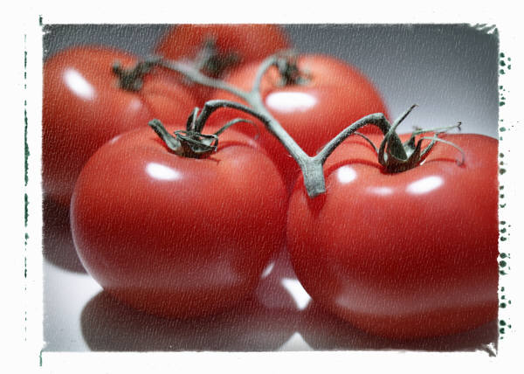
Biotechnology Timeline
1987
First field tests of genetically modified food plants are approved, for virus resistant tomatoes.

Slide 31
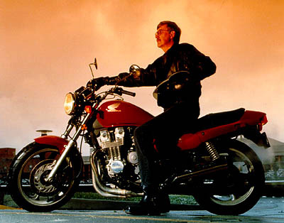
Biotechnology Timeline
1990
The Human Genome Project — an international effort to maps all of the genes in the human genome — is launched.
Francis Collins, M.D., Ph.D.
Director, Human Genome Project

Slide 32
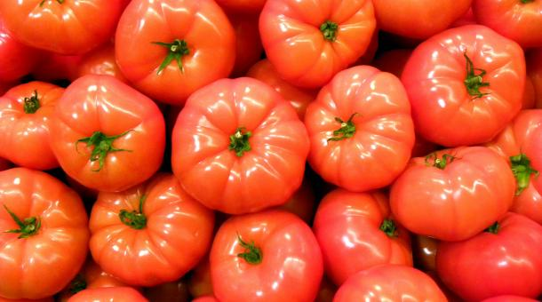
Biotechnology Timeline
1994
Genetically modified tomatoes are sold for the first time in the United States.
Notes:
Image taken from http://www.marketplace.org/topics/sustainability/states-consider-labeling-gmo-foods image listed as from Joost J. Bakker IJmuiden / Creative Commons

Slide 33
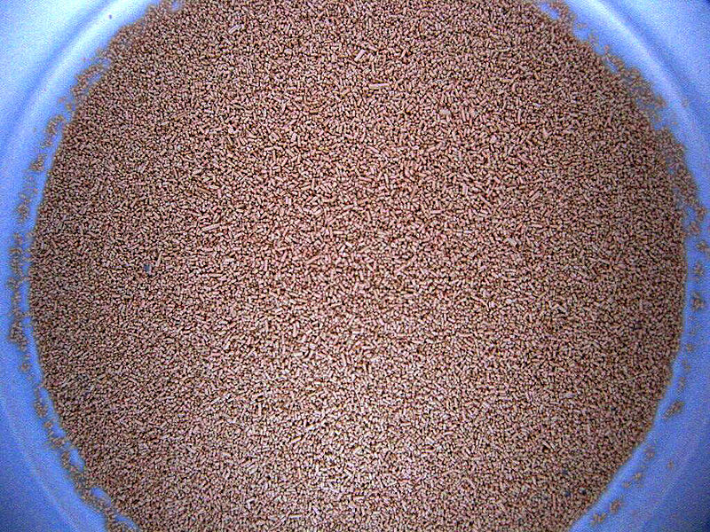
Biotechnology Timeline
1996
Sequencing of the baker’s yeast genome is completed.

Slide 34
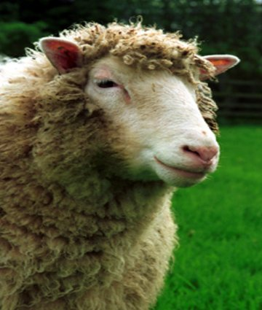
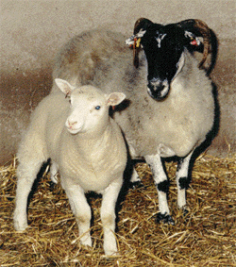
Biotechnology Timeline
1997
Scientists report the birth of Dolly, the first animal cloned from an adult cell.
Dolly (1996-2003) as an adult Dolly and her surrogate mother

Slide 35
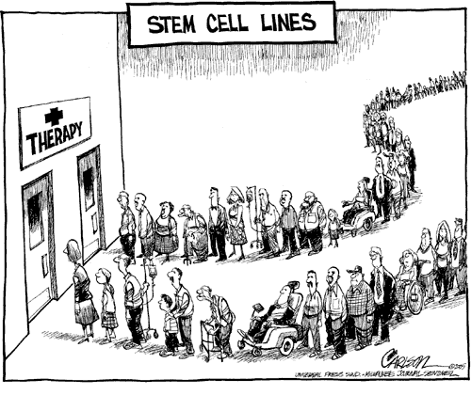
Biotechnology Timeline
1998
Human embryonic stem cell lines are established.
They offer hope to many
because they may be
able to replace diseased
or dysfunctional cells.

Slide 36
Biotechnology Timeline
2002
Draft version of the complete map of the human genome is published.

Slide 37
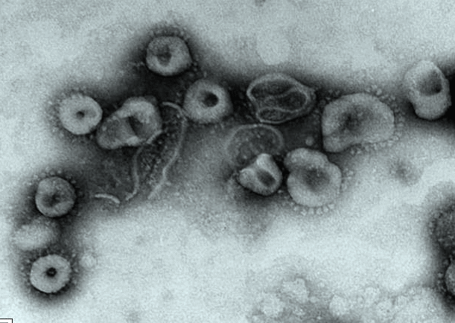
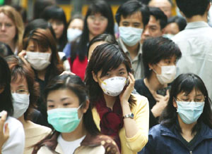
Biotechnology Timeline
2003
The SARS (severe acute respiratory
syndrome) virus is sequenced
three weeks after its discovery.
SARS, which began in China, spreads quickly — and spreads fear throughout the Far East and the world. The last reported cases occurred in 2004 and resulted from laboratory-acquired infections.

Slide 38
Biotechnology Timeline
2003
A far more precise version of the human genome—one that is 99.999%accurate—is published.

Slide 39
Biotechnology Timeline
2004
The first cloned pet — a kitten —
is delivered to its owner.
https://www.britannica.com/list/cc-the-first-cloned-cat
She is called CopyCat (or Cc for short).

Slide 40
Biotechnology Timeline
2004
Avastin, a recombinant monoclonal antibody, is the first targeted biological therapy of its kind to receive FDA approval

Slide 41
Biotechnology Timeline
2006
A vaccine against the human papillomavirus, which causes cancer of the cervix, receives FDA approval. The vaccine is made via recombinant DNA technology by inserting of the viral genes into the DNA of baker’s yeast.
The U.S. Department of Agriculture (USDA) grants Dow AgroSciences the first regulatory approval for a plant-made vaccine.
The Wake Forest Institute for Regenerative Medicine, in Winston-Salem, N.C., creates the first laboratory-grown organs by successfully transplanting bladders grown from a patient’s own cells. This method greatly reduces the risk of organ rejection.

Slide 42
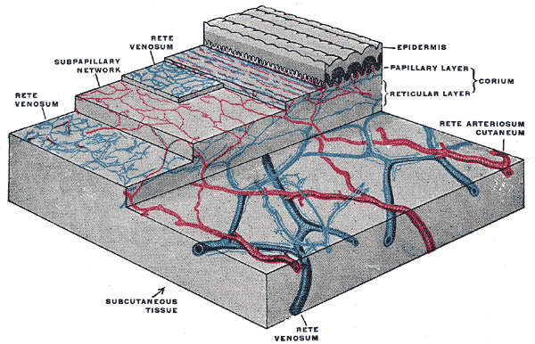
Biotechnology Timeline
2007
Scientists discover how to use human skin cells to create embryonic stem cells.

Slide 43
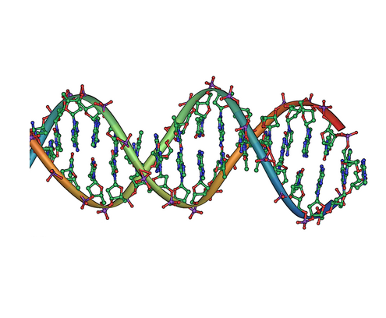
Biotechnology Timeline
2008
Japanese scientists create the first DNA molecule made almost entirely of artificial parts. This advances the field of gene therapy and brings scientists one step closer to creating an artificial organism.

Slide 44
Biotechnology Timeline
2009
U.S. Congress frees up federal funding for broader embryonic stem cell research.
Canadian-owned Medicago produces the first plant-based influenza vaccine, in tobacco leaves. Medicago has built a manufacturing facility in Durham, N.C., to scale up production.

Slide 45
Biotechnology Timeline
2010
Researchers at the J. Craig Venter Institute create the first synthetic cell.

Slide 46
Biotechnology Timeline
2011
A trachea derived from stem cells is transplanted into a human recipient.
Advances in 3D printing technology lead to “skin printing.”
European scientists begin clinical trials for an anti-HIV biotech medicine produced using genetically modified tobacco. This increases the potential for cost-effective HIV/AIDS therapy in the developing world.

Slide 47
Biotechnology Timeline
2012
The FDA issues draft guidelines for biosimilar drugs (follow-on biologics) as a growing percentage of biopharmaceuticals reach the end of patent protection.
Novartis, which has a manufacturing facility in Holly Springs, N.C., receives FDA approval for Flucelvax, the first cell-culture derived vaccine in the United States.

Slide 48
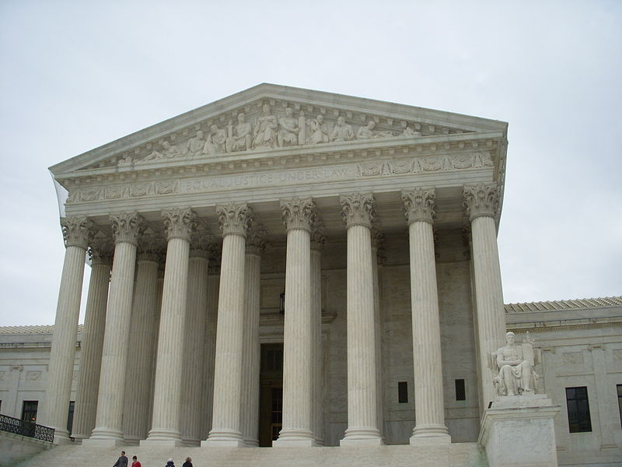
Biotechnology Timeline
2013
The U.S. Supreme
Court rules that
naturally occurring
genes cannot be
patented.

